Slide 1


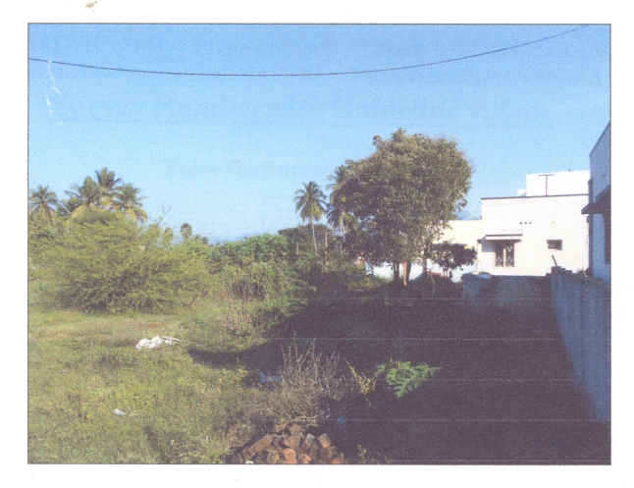

VACANT LAND
VL - 041
Location of Property | KOZHIMEKKANUR, SALEM
Total area of land | 2335.75 sq.fts
Constructed area | NA
Year of construction | NA
Current market value | Rs. 15.84 lacs

Slide 2
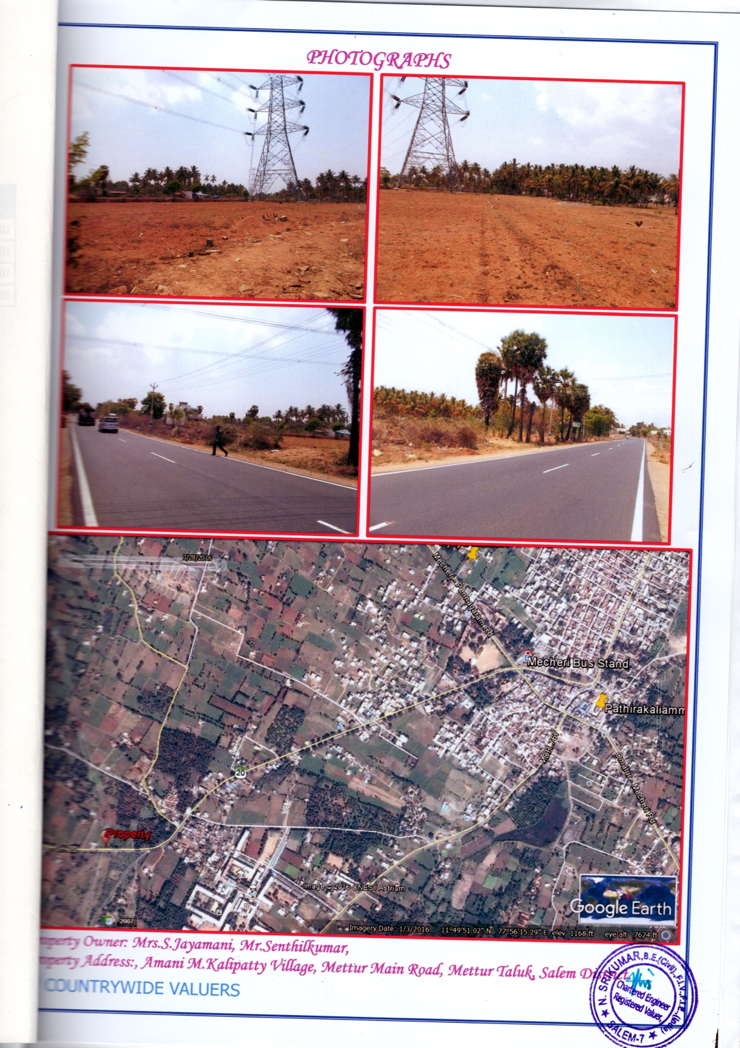
VACANT LAND
VL - 042
Location of Property | M KALLIPATTI, SALEM
Total area of land | 4974 sq.fts
Constructed area | NA
Year of construction | NA
Current market value | Rs. 22.30 lacs

Slide 3
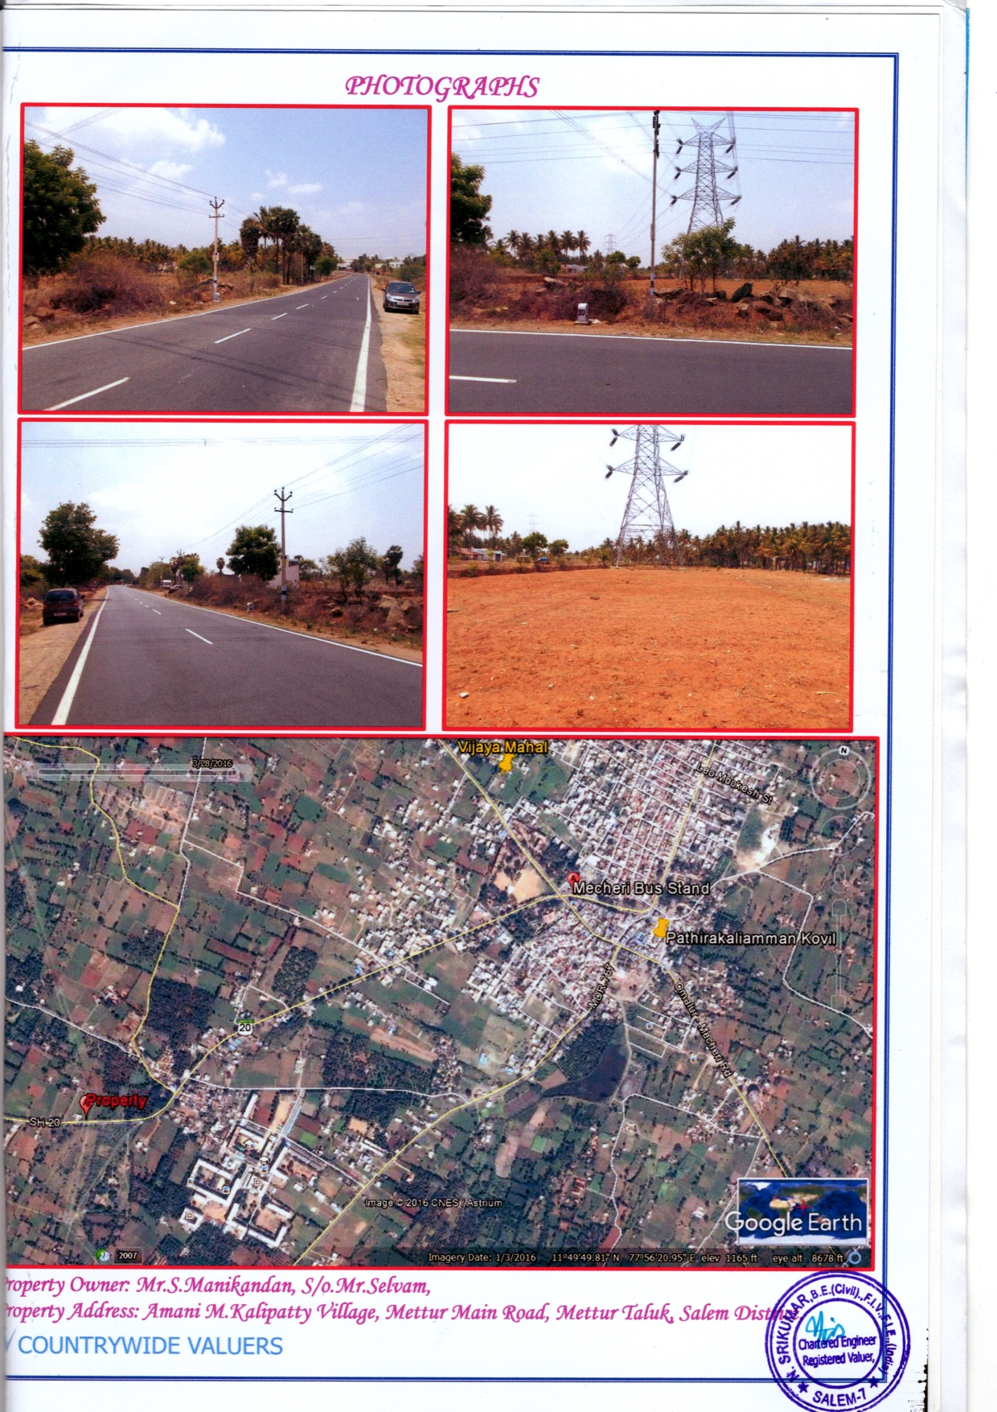
VACANT LAND
VL - 043
Location of Property | M KALLIPATTI, SALEM
Total area of land | 6552 sq.fts
Constructed area | NA
Year of construction | NA
Current market value | Rs. 29.48 lacs

Slide 4
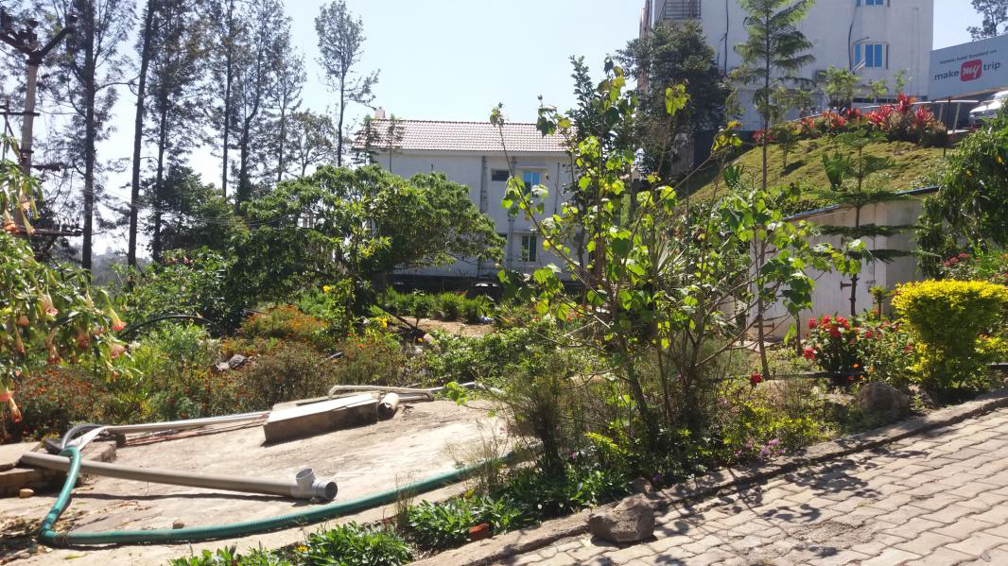
VACANT LAND
VL - 044
Location of Property | KILLIYUR VILLAGE , YERCAUD, SALEM
Total area of land | 2844. sq.ft
Constructed area
Year of construction
Current market value | Rs. 42.65 lacs

Slide 5
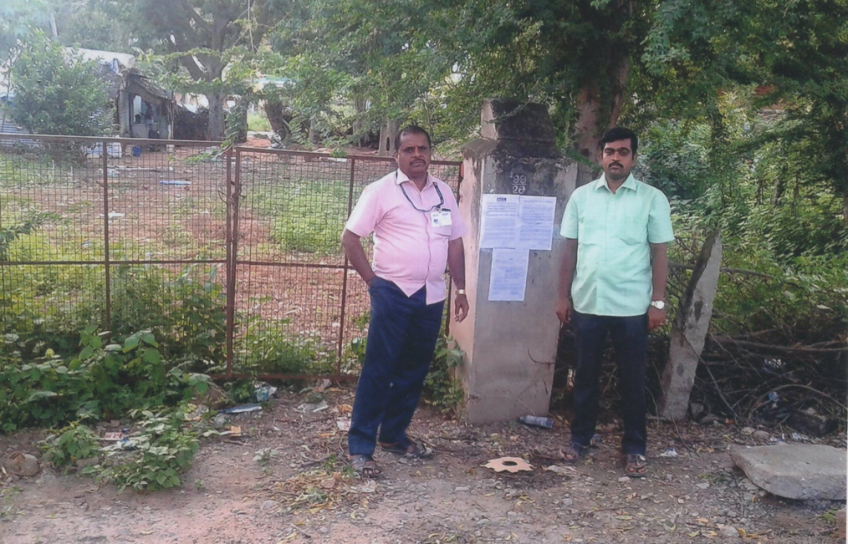
VACANT LAND
VL - 045
Borrower Name | M/s Maankutty Agro
Location of Property | BODINAYAKANUR, Theni Dist.
Total area of land | 3600 Sq.Ft
Constructed area | Vacant Land
Current market value | Rs. 36.00 lakhs

Slide 6
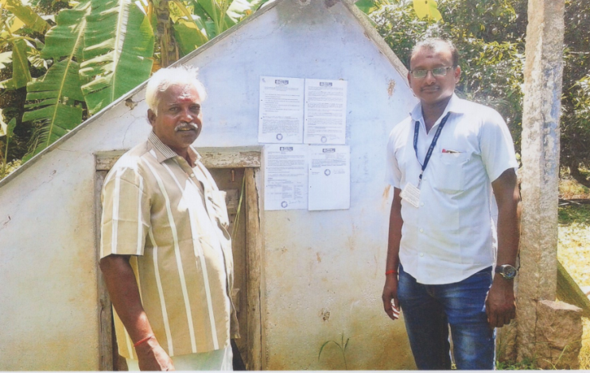
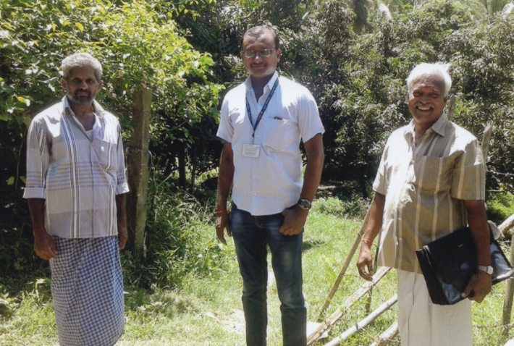
MANGO ORCHARD – VACANT LAND
VL - 046
Borrower Name | SYED ABDAGIR
Location of Property | BODINAYAKANUR, Theni Dist.
Total area of land | 5.64 Ac + 5.30 Ac = 10.94 Acres
Constructed area | 80 Sq.ft (Motor Room)
Current market value | Rs.45.12 L (5.64 Ac) + Rs.42.40 L (5.30 Ac)

Slide 7
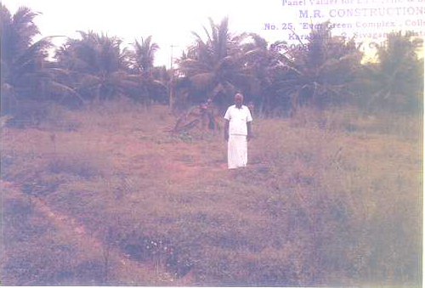
VACANT LAND
VL - 047
Location of Property | Sivagangai
Total area of land | 2073 cents
Constructed area | NA
Year of construction | NA
Current market value | Rs 82.90 lakhs
Sale value | FSV Rs 62.10 lakhs

Slide 8
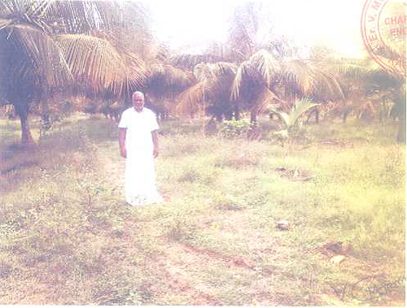
VACANT LAND
VL - 048
Location of Property | Sivagangai
Total area of land | 3474 cents
Constructed area | NA
Year of construction | NA
Current market value | Rs 138.90 lakhs
Sale value | FSV Rs 111.00 lakhs

Slide 9
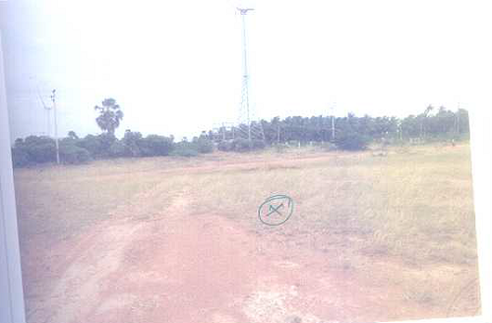
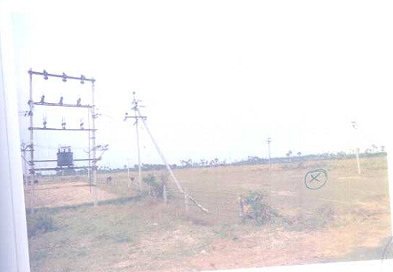
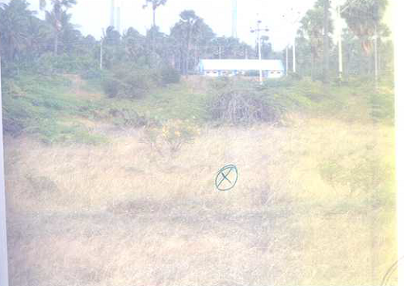
VACANT LAND
VL- 049
Location of Property | Kanyakumari - Chiramadam
Total area of land | 38.606 cents
Constructed area | NA
Year of construction | NA
Current market value | Rs 9.65 lakhs
Sale value | FSV Rs 8.68 lakhs

Slide 10
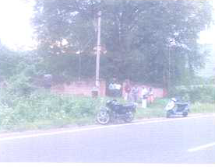
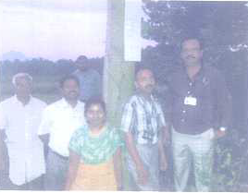
VACANT LAND
VL - 050
Location of Property | Theni
Total area of land | 5.22 Acres
Constructed area | NA
Year of construction | NA
Current market value | Rs 107.55 lakhs
Sale value | FSV Rs 91.42 lakhs

Slide 11
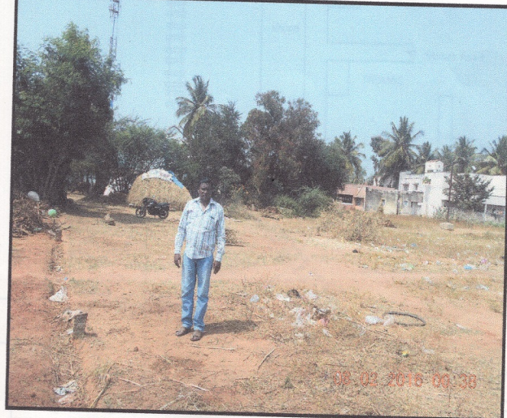

VACANT LAND
VL - 051
Location of Property | ILLAKIYAMPATTI,DHARMAPURI
Total area of land | 4250 sq.ft
Constructed area | N.A
Year of construction | N.A
Current market value | Rs. 60.56 Lacs

Slide 12
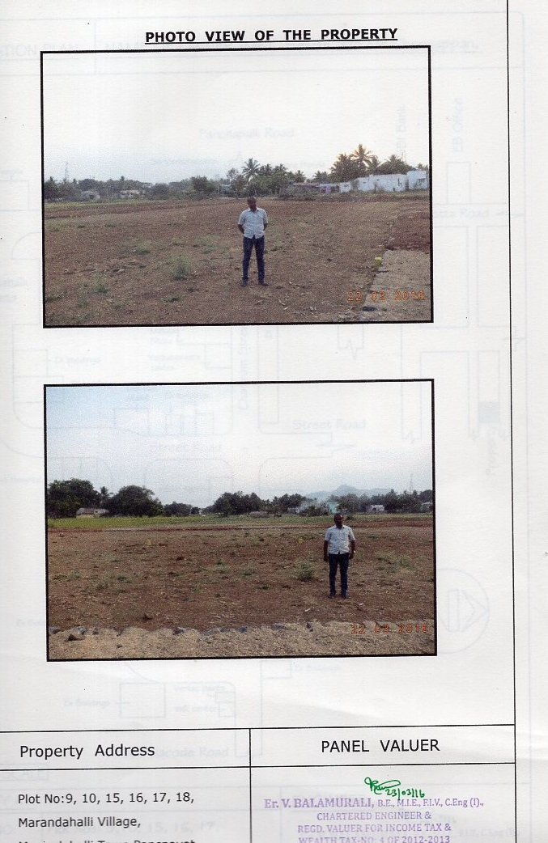
VACANT LAND
VL - 052
Location of Property | MARANDAHALLI,DHARMAPURI
Total area of land | 7148 sq.ft
Constructed area | N.A
Year of construction | N.A
Current market value | Rs. 19.30 Lacs

Slide 13
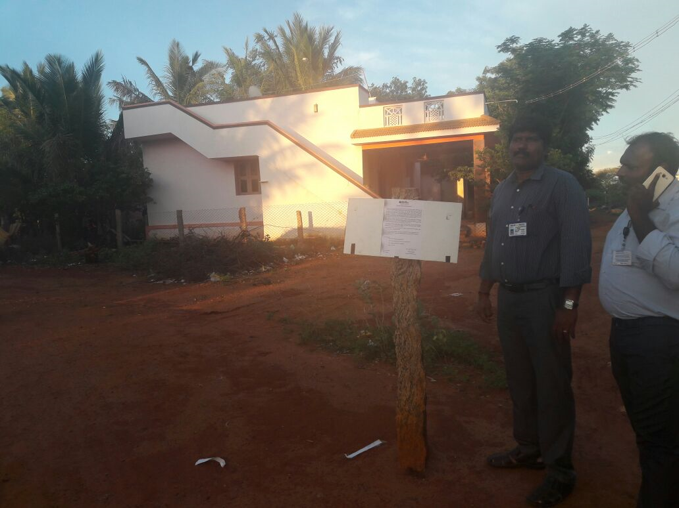
VACANT LAND
VL - 053
Location of Property | MELAVANIYANGUDI,SIVAGANGAI
Total area of land | 2000 sq.ft
Constructed area | NA
Year of construction | NA
Current market value | Rs. 4.37 Lacs

Slide 14
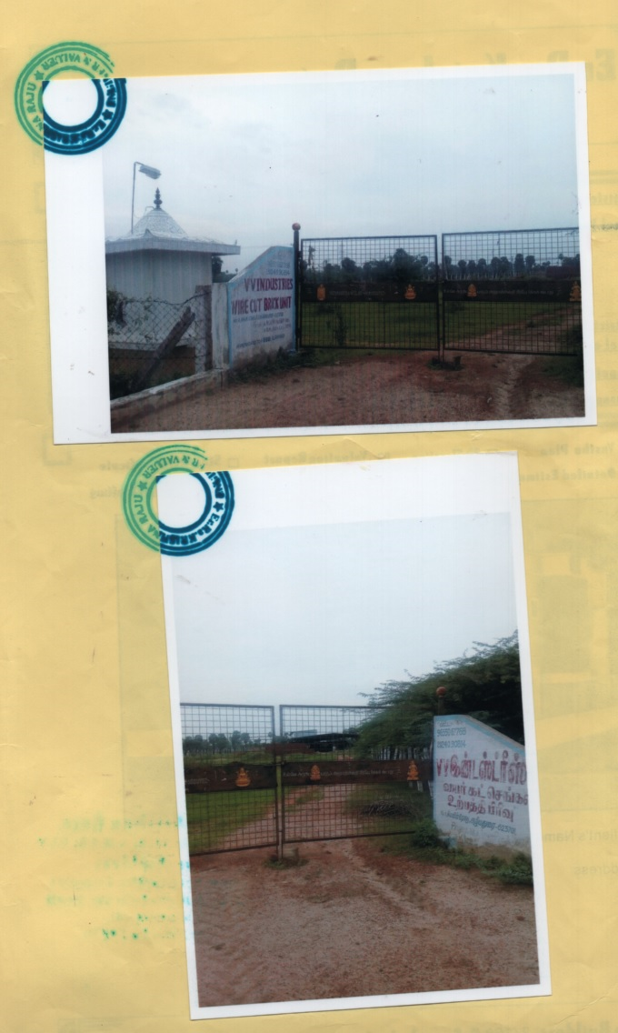
VACANT LAND
VL - 054
Location of Property | KATTUPARMAKUDI
Total area of land | 2 Acres 35 Cents
Constructed area | GI SHEET BUILDING 27500 sq.ft
Year of construction | 2014
Current market value | Rs. 32.68 Lacs

Slide 15
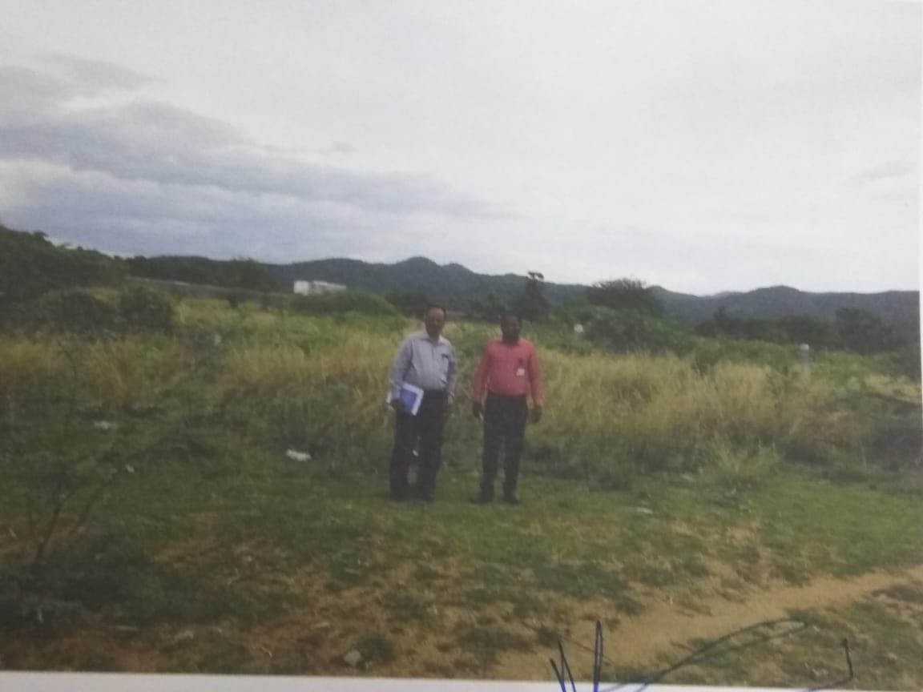
VACANT LAND
VL - 055
Location of Property | M/S Point Sports Apparels- AnnaNagar Br ChathiraThondampatti Village, Madurai North Taluk
Total area of land | 2000 sq.ft
Constructed area | Land only
Year of construction | NA
Current market value | Rs. 3.71 lacs
Sale value | Rs. 2.78 lacs

Slide 16
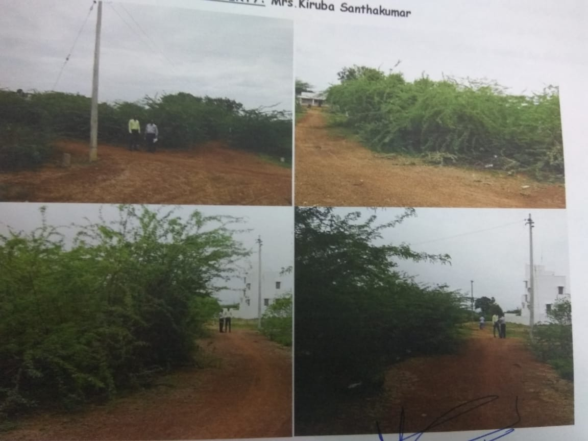
VACANT LAND
VL - 056
Location of Property | M/S Point Sports Apparels- AnnaNagar Br Pottapaniyur Village, Madurai North Taluk
Total area of land | 7380 sq.ft
Constructed area | Land only
Year of construction | NA
Current market value | Rs. 5.31 lacs
Sale value | Rs. 3.98 lacs

Slide 17
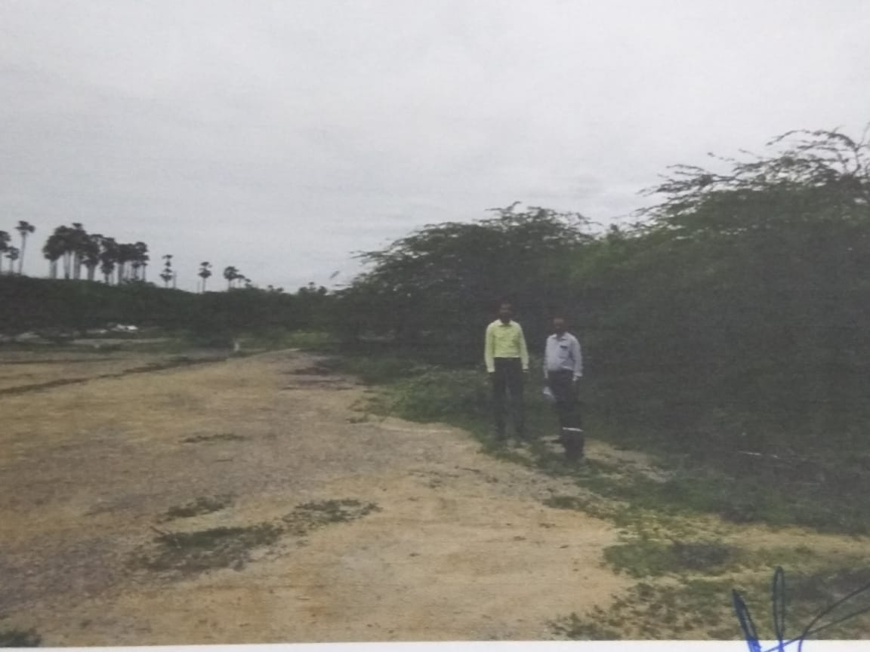
VACANT LAND
VL - 057
Location of Property | M/S Point Sports Apparels- AnnaNagar Br Konthagai Village, ManamaduraiTaluk
Total area of land | 3800 sq.ft
Constructed area | Land only
Year of construction | NA
Current market value | Rs. 0.95 lacs
Sale value | Rs. 0.95 lacs

Slide 18
VACANT LAND
VL - 058
Location of Property | M/S Star General Traders ARMB Chidambaram Village, Radhapuram Tk,Kanyakumari.
Total area of land | 38.606 cents
Constructed area | NA
Year of construction | NA
Current market value | Rs 9.65 lakhs
Sale value | FSV Rs 8.68 lakhs

Slide 19
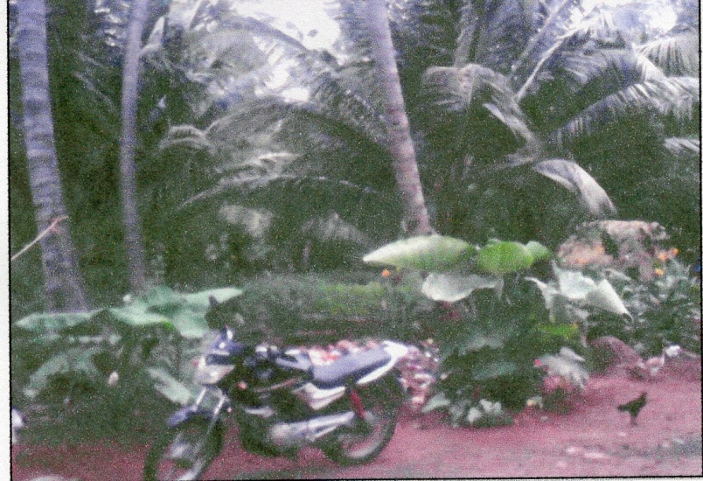
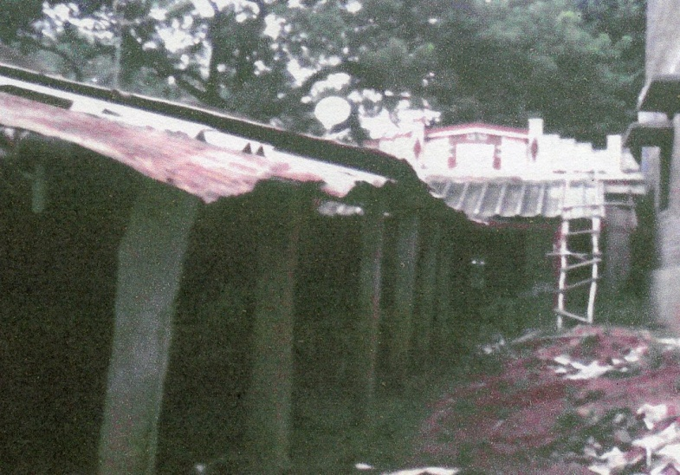
VACANT LAND
VL - 059
Borrower Name | P Duraisingam S/o Perumal Thevar
Location of Property | KUTCHANUR, Theni Dist.
Total area of land | 1.62 Acres
Constructed area | Agri Land
Current market value | Rs. 29.08 lakhs
Sale value | Rs. 21.81 lakhs

Slide 20
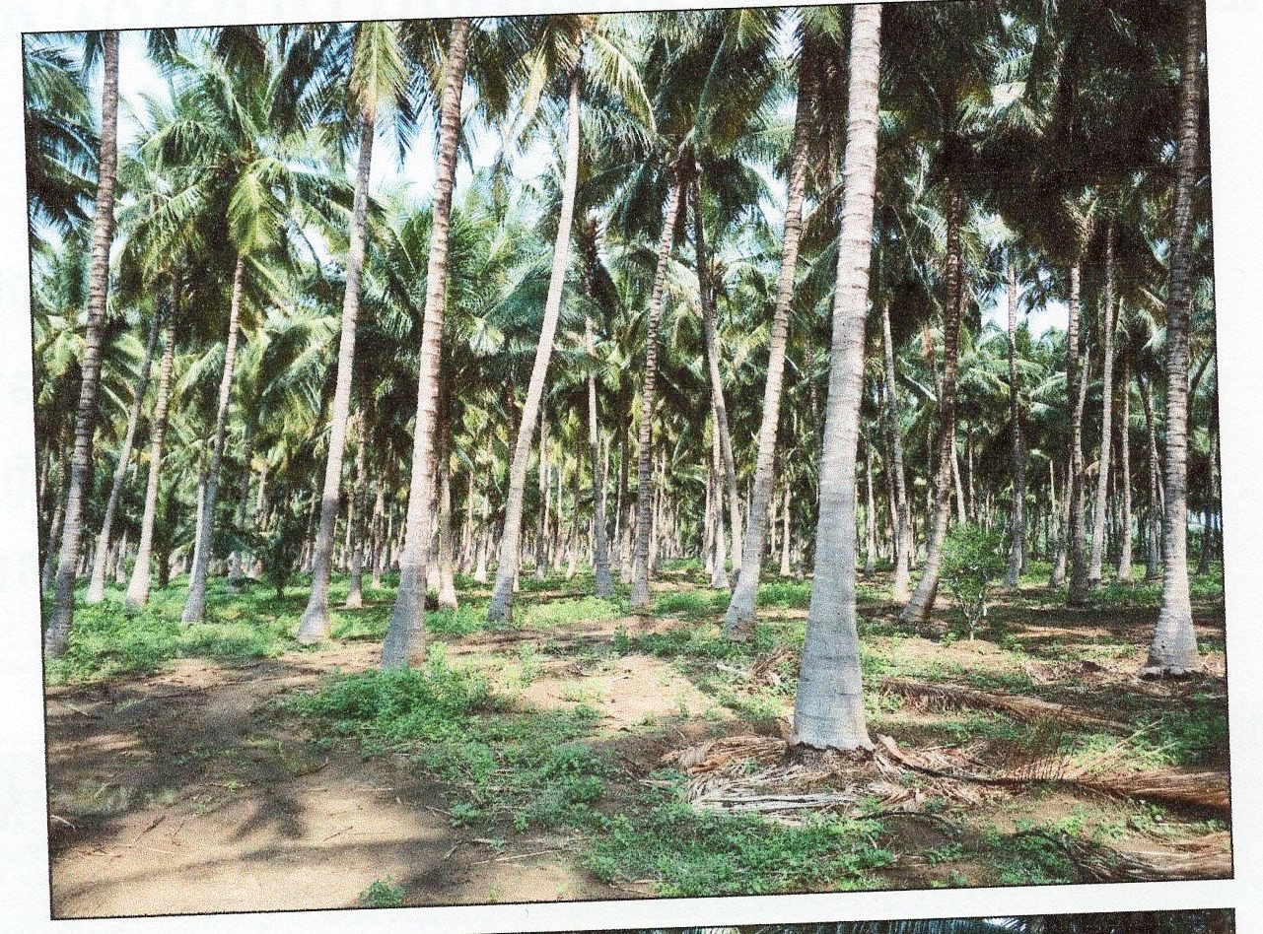
VACANT LAND
VL- 060
Borrower Name | Mr.N.Palanichamy
Location of Property | Bodinayakanur, Theni Dist
Total area of land | 9.52 Acres
Type of Crop | Coconut Plantation
Current market value | Rs. 76.16 lakhs
Sale value | Rs. 57.12 lakhs

Slide 21
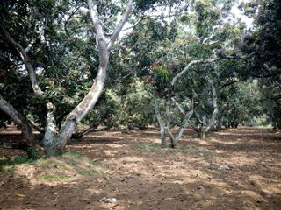
VACANT LAND
VL- 061
Borrower Name | Mr.Thangappa & Raja Mohammed
Location of Property | Bodinayakanur, Theni Dist
Total area of land | 10.33 Acres
Type of Crop | Mango Plantation
Current market value | Rs. 98.13 lakhs
Sale value | Rs. 73.60 lakhs

Slide 22
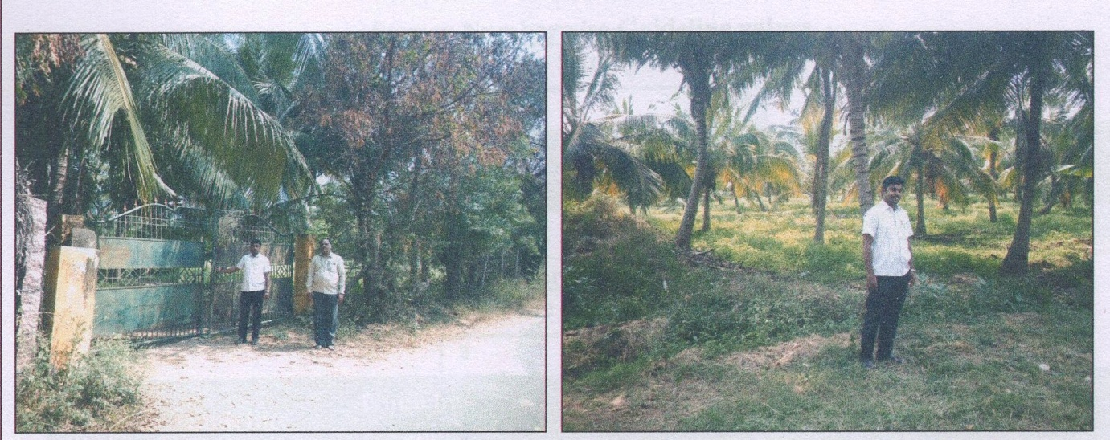
VACANT LAND
VL- 062
Borrower Name | M/s Frozen Fruits & Vegetables
Location of Property | Bodinayakanur, Theni Dist
Total area of land | 7.33 Acres
Type of Crop | Coconut Plantation
Current market value | Rs. 131.98 lakhs
Sale value | Rs. 98.99 lakhs

Slide 23
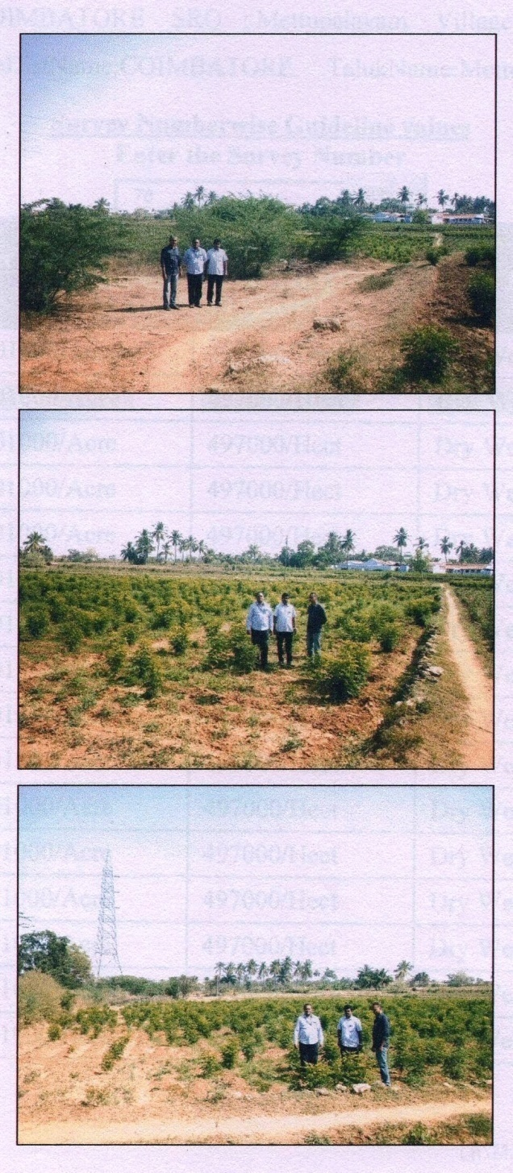
VACANT LAND
VL- 063
Borrower Name | M/s Frozen Fruits & Vegetables
Location of Property | Bellathi Village, Coimbatore Dist
Total area of land | 1.03 Acres
Type of Crop | Curry Leaves Plantation
Current market value | Rs. 5.15 lakhs
Sale value | Rs. 3.86 lakhs

Slide 24
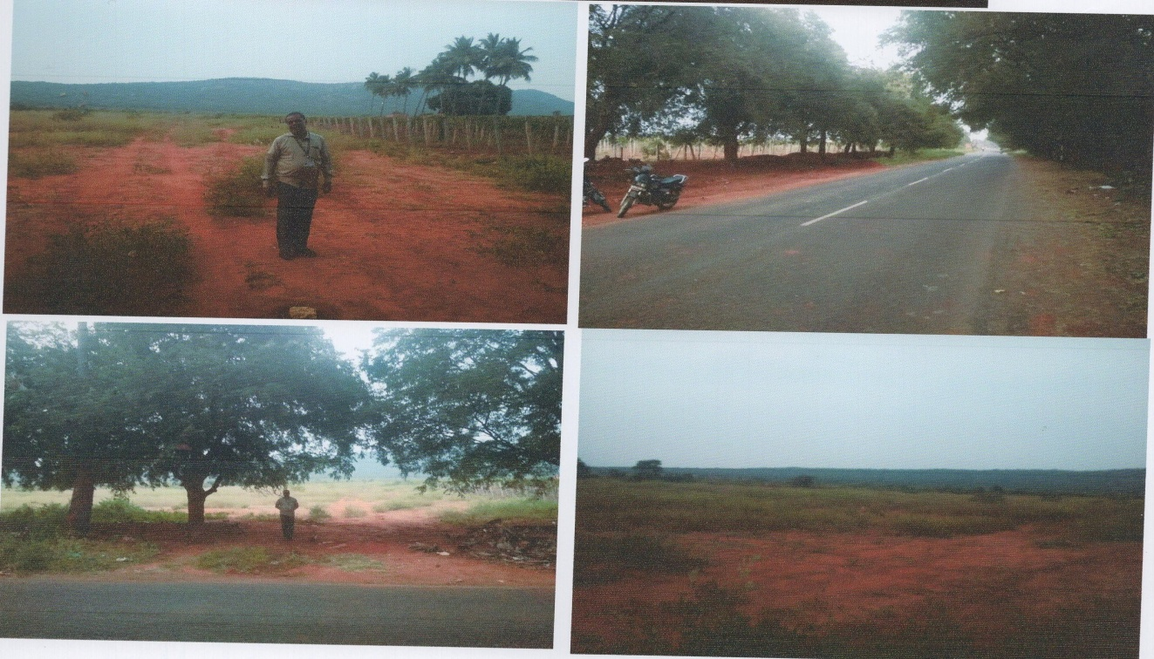
VACANT LAND
VL- 064
Borrower Name | M/s Frozen Fruits & Vegetables
Location of Property | Seeppala Kottai, Theni Dist
Total area of land | 18.34 Acres
Type of Crop | Vacant Land
Current market value | Rs. 286.10 lakhs
Sale value | Rs. 228.80 lakhs

Slide 25
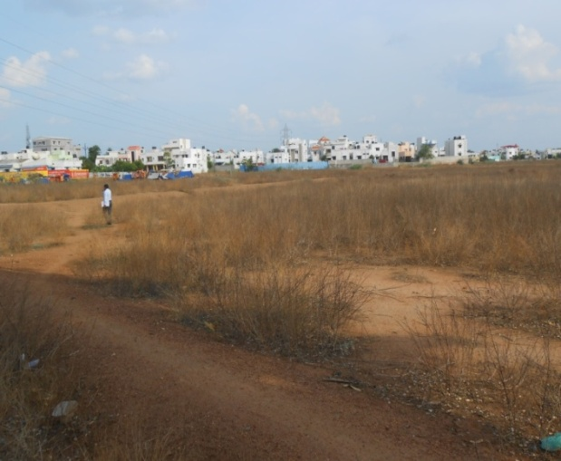
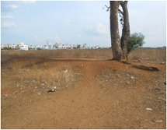
VACANT LAND
VL- 065
Location of Property | M/S PRP Exports Madurai Main THERKKUTHERU, MELUR, MADURAI
Total area of land | 3.07 Acres
Constructed area | Nil
Year of construction | Nil
Current market value | Rs. 21.49 Cr
Sale value | Rs.19.34 Cr

Slide 26
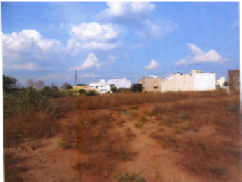
VACANT LAND
VL – 066
Location of Property | M/S PRP Exports Madurai Main UTHANGUDI, MADURAI
Total area of land | 1.10 Acres
Constructed area | Nil
Year of construction | Nil
Current market value | Rs. 1.37 Cr
Sale value | Rs.1.24 Cr

Slide 27
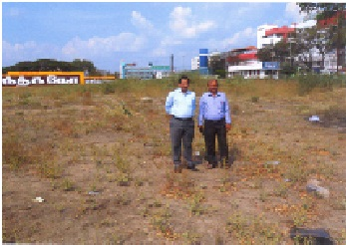
VACANT LAND
VL- 067
Location of Property | M/S PRP Exports Madurai Main UTHANGUDI, MADURAI
Total area of land | 3.33 Acres
Constructed area | Nil
Year of construction | Nil
Current market value | Rs. 36.63 Cr
Sale value | Rs. 32.96 Cr

Slide 28
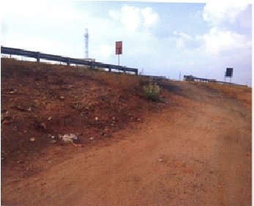
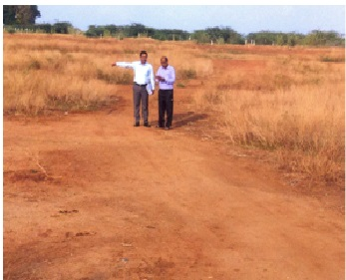
VACANT LAND
VL- 068
Location of Property | M/S PRP Exports Madurai Main ELANTHAIKULAM, MADURAI
Total area of land | 3.625 Acres
Constructed area | Nil
Year of construction | Nil
Current market value | Rs. 14.50 Cr
Sale value | Rs.13.05 Cr

Slide 29
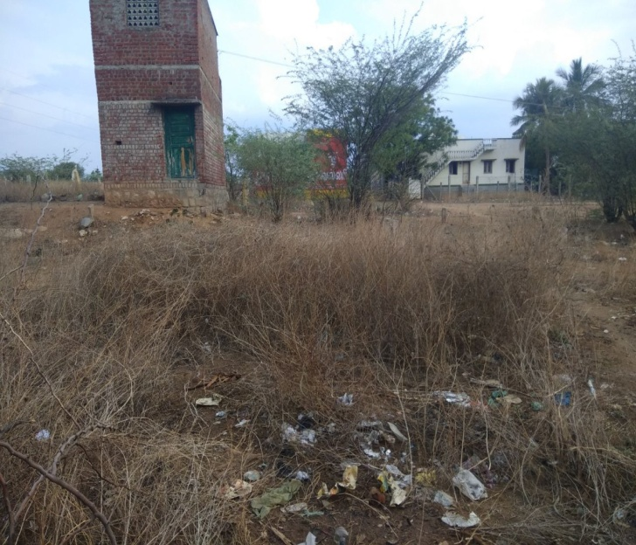
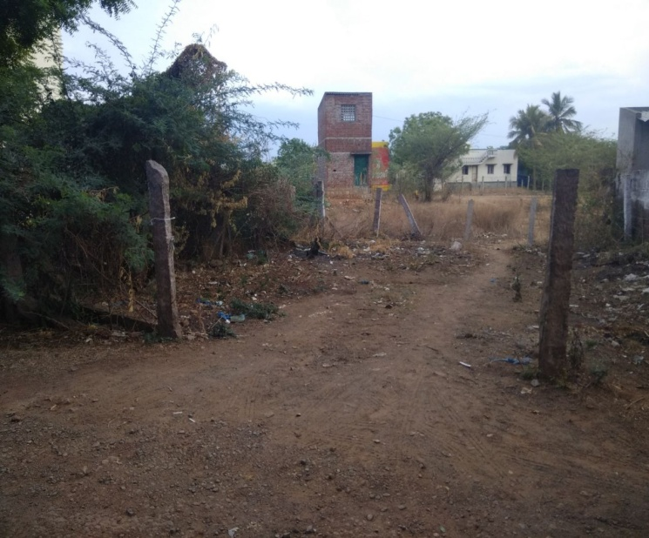
VACANT LAND
VL- 069
Location of Property | M/S PRP Exports Madurai Main VANDIYUR, MADURAI
Total area of land | 19.76 Cents
Constructed area | Nil
Year of construction | Nil
Current market value | Rs. 1.38 Cr
Sale value | Rs. 1.24 Cr

Slide 30
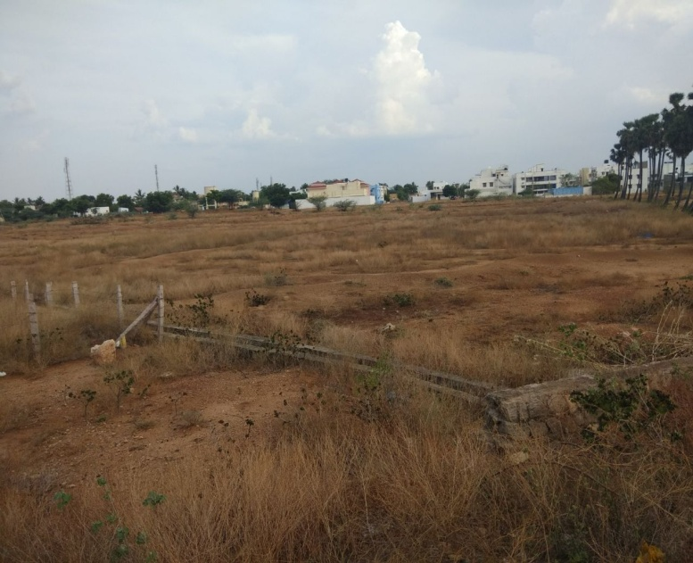
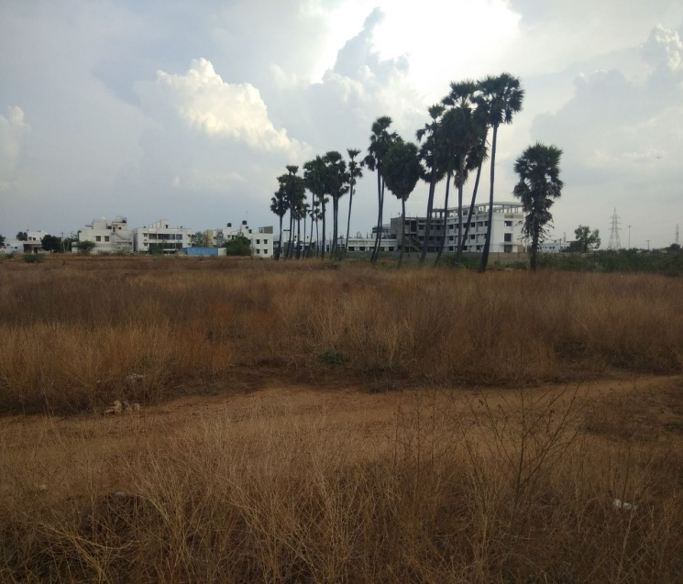
VACANT LAND
VL- 070
Location of Property | M/S PRP Exports Madurai Main MELAMADAI, MADURAI
Total area of land | 2.29 Acres
Constructed area | Nil
Year of construction | Nil
Current market value | Rs. 8.02 Cr
Sale value | Rs. 7.21 Cr

Slide 31
VACANT LAND
VL- 071
Location of Property | Mr Mahaboobjohn MaduraiMain Palamedu, Madurai Dist
Total area of land | 6250 Sq. Ft
Constructed area | Nil
Year of construction | Nil
Current market value | Rs. 30.56 Lakhs
Sale value | Rs. 27.50 Lakhs

Slide 32
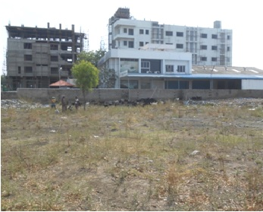
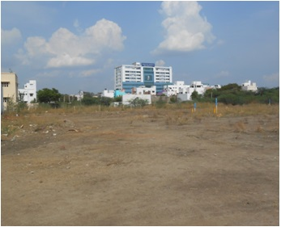
VACANT LAND
VL- 072
Location of Property | M/S PRP Exports Madurai Main UTHANGUDI, MADURAI
Total area of land | 8.25 Acres
Constructed area | Nil
Year of construction | Nil
Current market value | Rs. 62.13 Cr
Sale value | Rs. 51.92 Cr

Slide 33
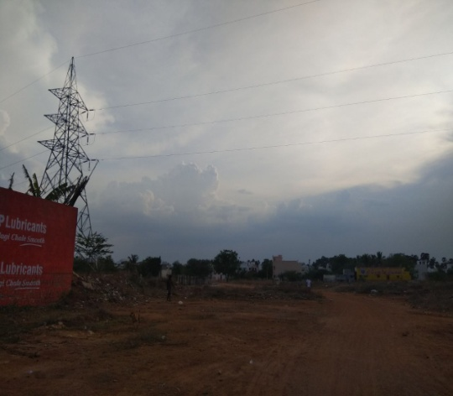
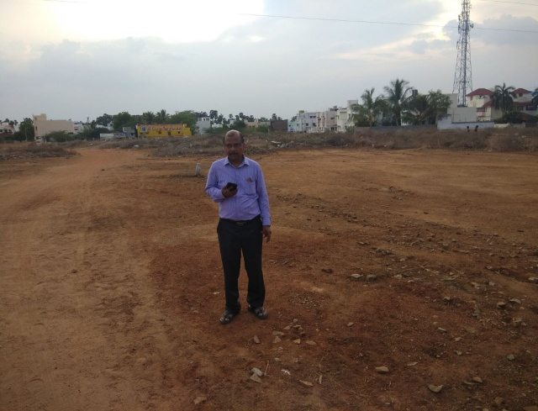
VACANT LAND
VL- 073
Location of Property | M/S PRP Exports Madurai Main VANDIYUR, MADURAI
Total area of land | 2.51 Acres
Constructed area | Nil
Year of construction | Nil
Current market value | Rs. 11.80 Cr
Sale value | Rs. 10.62 Cr

Slide 34
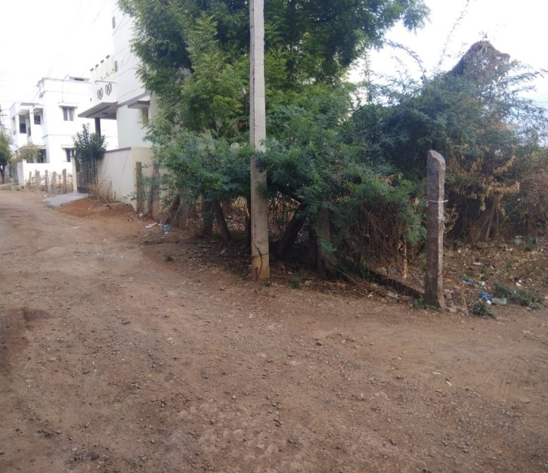
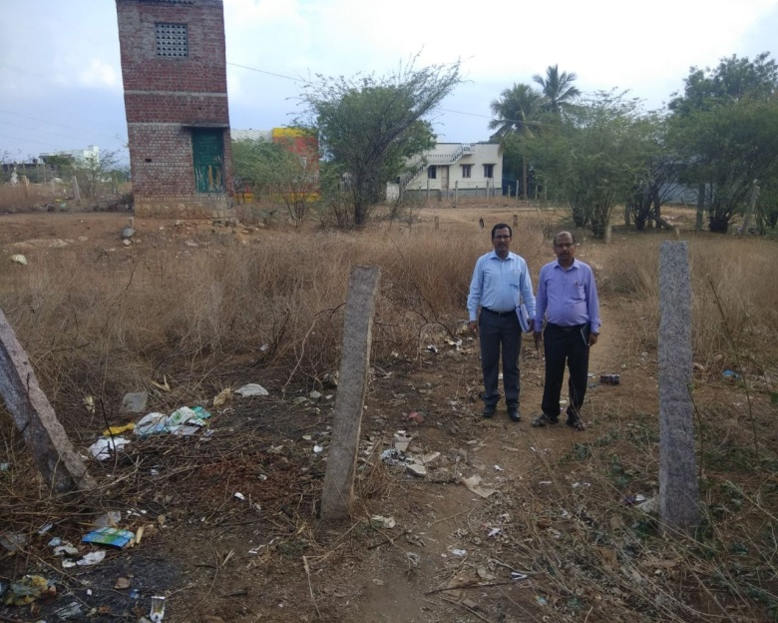
VACANT LAND
VL- 074
Location of Property | VANDIYUR, MADURAI
Total area of land | 1230 Sq.Ft
Constructed area | Nil
Year of construction | Nil
Current market value | Rs. 0.25 Cr
Sale value | Rs. 0.23 Cr

Slide 35
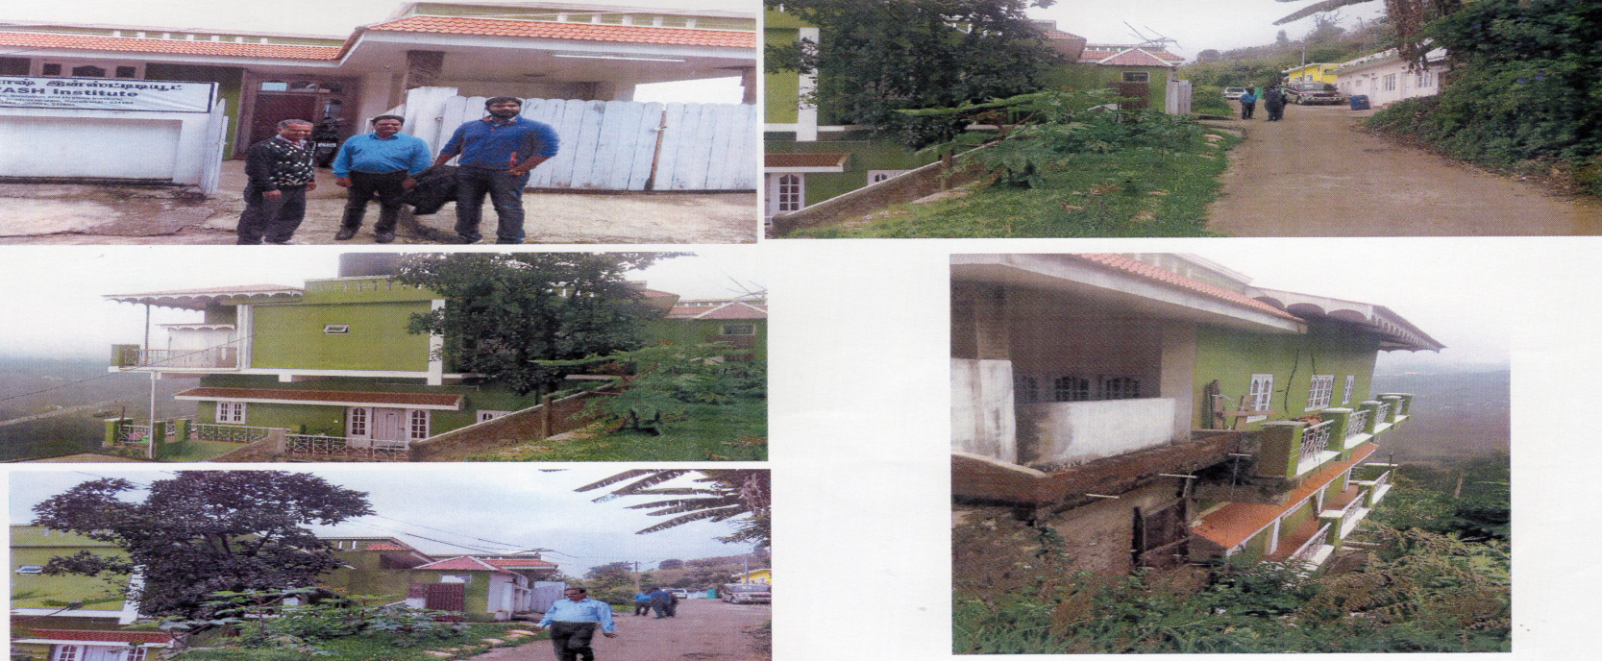
VACANT LAND
VL - 075
Borrower Name | S Teena Sumisen
Location of Property | s.no.7/37, Ward-D, Block no.20, Kodaikanal Tk, Dindigul Dist.
Total area of land | 3 cents
Constructed area | GroundFloor 64.96 sq.mt,First Floor 64.96 sq.m
Current market value | Rs. 50.60 lakhs
Sale value | Rs. 45.54 lakhs

Slide 36
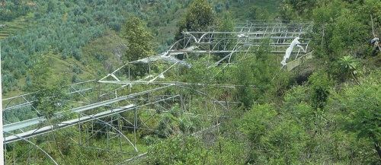
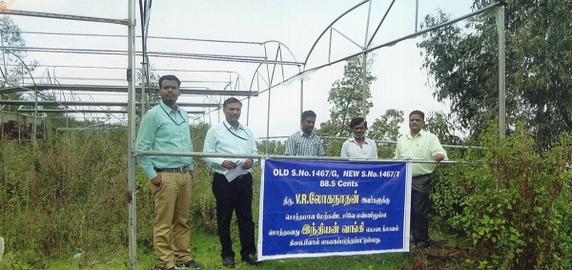
VACANT LAND
VL - 076
Location of Property | Mr VR Loganathan Kodaikanal Branch Mannavanoor village Kodaikanal
Total area of land | 1.77 acre
Constructed area | NIL
Year of construction | NIL
Current market value | Rs. 21.25 lacs
Sale value | Rs. 18.60 lacs

Slide 37
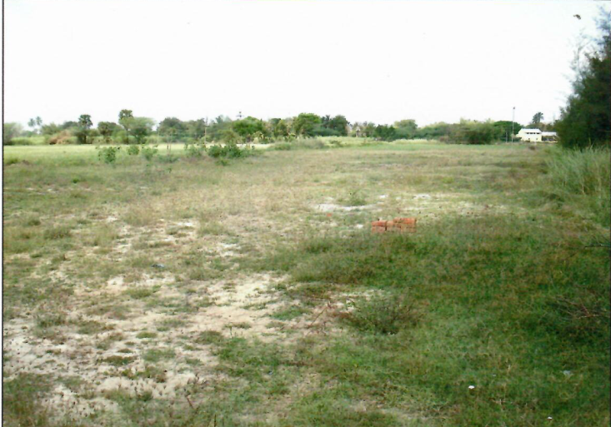
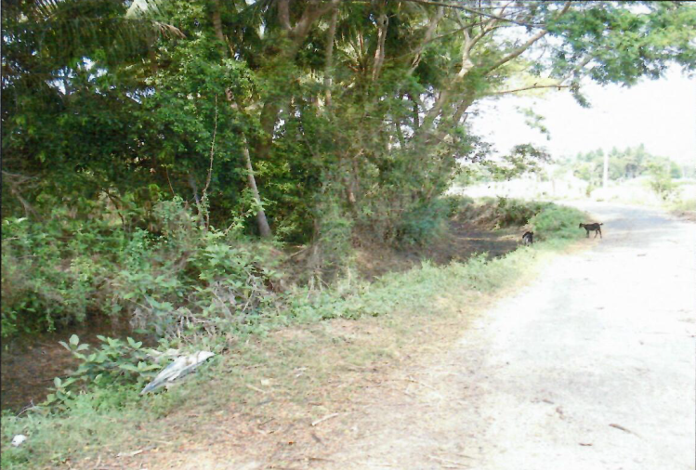
VACANT LAND
VL - 077
Location of Property | KOTTUCHERRY,KARAIKAL
Total area of land | 33786 sq.ft
Constructed area | NA
Year of construction | NA
Current market value | Rs. 506.79 Lacs

Slide 38
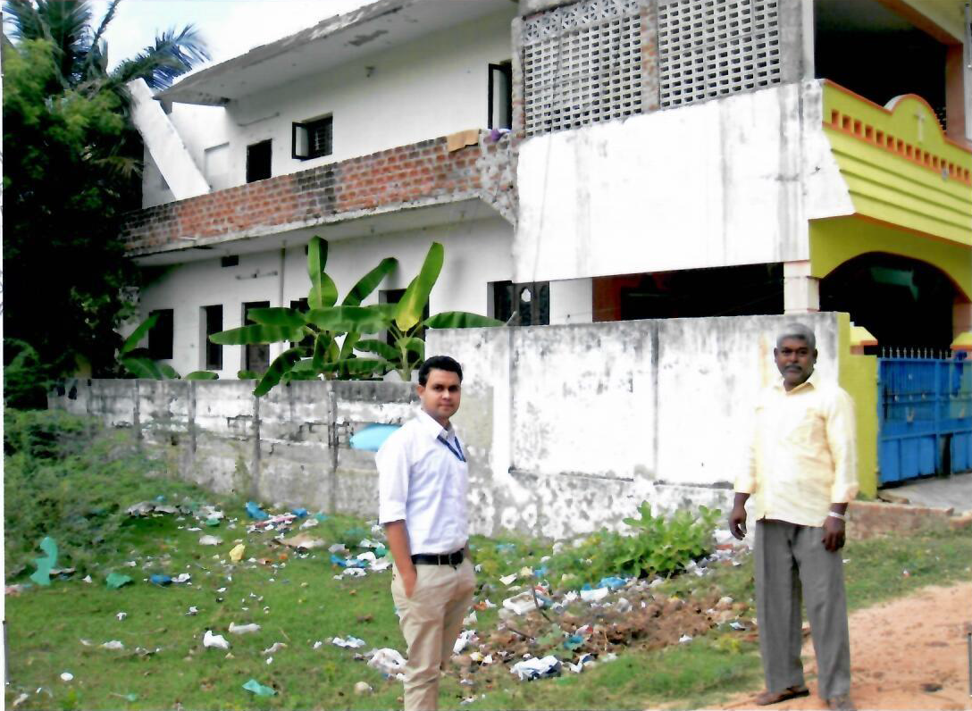
VACANT LAND
VL- 078
Location of Property | V.O.C NAGAR KOTTUCHERRY,KARAIKAL
Total area of land | 1841 sq.ft
Constructed area | NA
Year of construction | NA
Current market value | Rs. 12.90 Lacs

Slide 39

VACANT LAND
VL - 079
Location of Property | V.O.C NAGAR KOTTUCHERRY,KARAIKAL
Total area of land | 2411 sq.ft
Constructed area | NA
Year of construction | NA
Current market value | Rs. 16.90 Lacs

Slide 40

VACANT LAND
VL - 080
Location of Property | KOTTUCHERRY,KARAIKAL
Total area of land | 4 Acre 58 ½ Cents
Constructed area | NA
Year of construction | NA
Current market value | Rs.91.70 Lacs

Slide 41

VACANT LAND
VL - 081
Location of Property | KOTTUCHERRY,KARAIKAL
Total area of land | 1 Hect 37 Are
Constructed area | NA
Year of construction | NA
Current market value | Rs. 26.00 Lacs

Slide 42

VACANT LAND
VL - 082
Location of Property | THARANGAMBADI,NAGAPATTINAM
Total area of land | 1 Acre 166 2/3 Cents
Constructed area | NA
Year of construction | NA
Current market value | Rs. 26.00 Lacs

Slide 43


VACANT LAND
VL - 083
Location of Property | THIRUNALLAR ,KARAIKAL
Total area of land | 2740 sq.ft
Constructed area | NA
Year of construction | NA
Current market value | Rs. 6.85 Lacs

